Slide 1
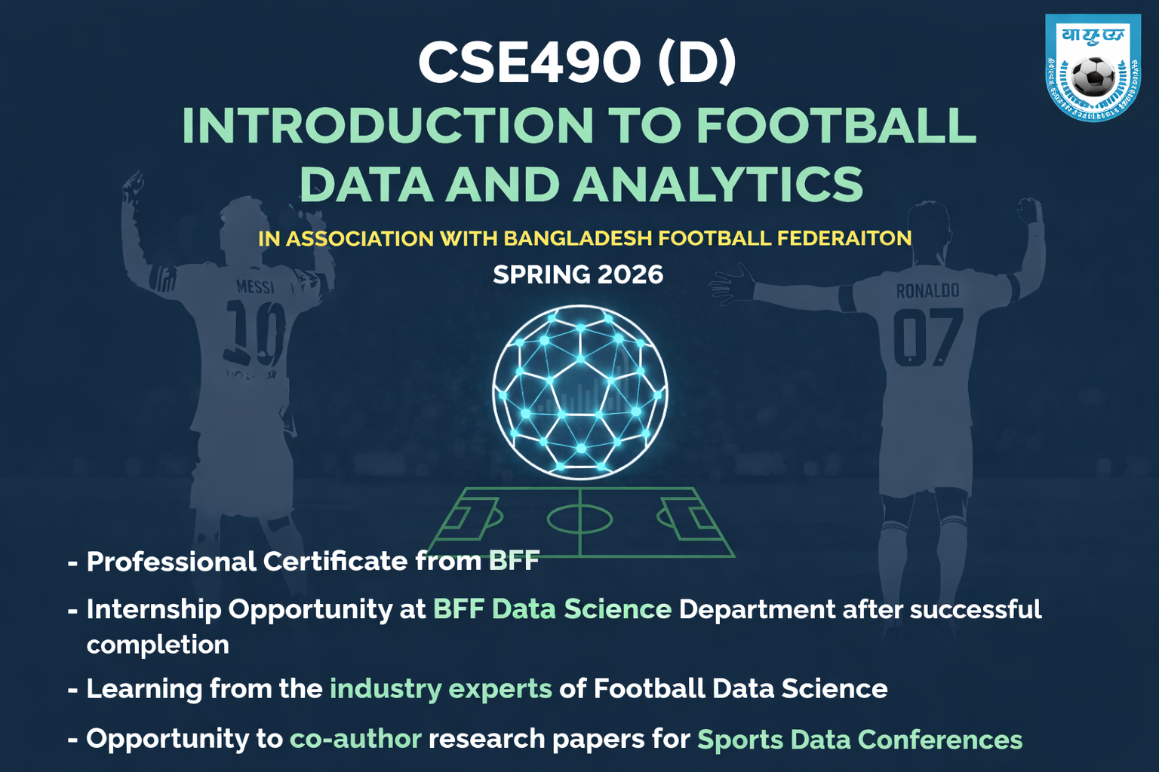



Slide 2
CSE490 (D)
Introduction to
Football Data & Analytics
Lecture-1
Prepared by-
Tarvir Anjum Aditto
Lecturer,
CSE, Brac University

Slide 3
Course Objectives
Introduce research-oriented football analytics using computing and statistical methods
Develop analytical, modeling, and visualization skills using real-world data
Foster independent research, critical thinking, and lifelong learning
Strengthen ethical reasoning, teamwork, and professional communication

Slide 4
Course Content
Module | Lessons
Data Foundations & Visualization | Introduction to Event Data & KPIs; Visualizing Football; Passing Networks & Team Structure
Statistical Models & Expected Goals | Choosing & Fitting Models; Advanced Models; Building an xG Model
Player & Action Valuation | Scouting and Player Profiles; Valuing Specific Actions
Uncertainty, Prediction & Trends | Randomness in Football; Team-Level KPIs & Trend Analysis
Space Control & Player Movement | Pitch Control Tools; Off-Ball Movement & Positioning
Physical Data & Clustering Techniques | Physical Performance Metrics; Clustering in Football Analytics

Slide 5
Assessment Structure
Assessment | Weight
Quiz | 10%
Midterm | 20%
Research Project | 30%
Mini Case Study | 10%
Final | 20%
Research Presentation | 10%

Slide 6
Research Project
Nature
● Individual or group (max 3 students)
● Dataset: StatsBomb / Wyscout / Open football data
Deliverables
Research proposal
Literature review
Methodology & modeling
Results & discussion
Ethical considerations
Final report & presentation

Slide 7
Research Project Structure
Assessment | Weight
Problem Formulation | 15%
Literature Review | 15%
Methodology | 20%
Analysis & Validation | 25%
Ethics & Limitation | 10%
Communication | 15%

Slide 8
Tools
Python
Open datasets: StatsBomb / WyScout
Libraries: pandas, numpy, matplotlib, mplsoccer, statsbombpy
N:B: We will mostly use google colab, but it’s better if you have conda/ VScode installed

Slide 9
Statsbomb (Data structure)
Follow this notebook- https://colab.research.google.com/drive/11izIsskxXn91-AVLfADYO0GOR1sFivDd?usp=sharing
Data Structure: Competition → Season → Match → Events
How to access data:
StatsBomb assigns unique IDs at each level
Each competition, season, and match has its own ID
Example
Competition: FIFA World Cup, competition_id = 43
Season: 2018, season_id = 106
Match: England vs Colombia, match_id = 7580

Slide 10
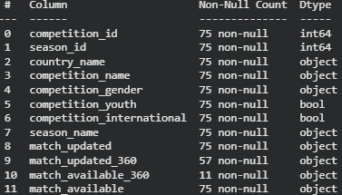
Statsbomb (Competitions)
Loading competitions as a DataFrame:
Provides high-level information such as:
  Competition name / country
  Season
  Number of matches
  Gender
  Availability of 360 data

Slide 11
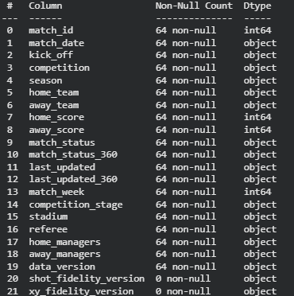
Statsbomb (Matches)
Loading matches for a competition as a DataFrame:
Provides match-level information such as:
  Home team & away team
  Match score
  Stadium
  Match stage
  Referee
  Team managers
  Match date

Slide 12
Statsbomb (Events)
Loading events for a match as a DataFrame:
Each row represents one on-ball action
Examples of events:
  Pass
  Shot
  Foul
  Duel
  Clearance
Information stored in event data includes:
Event type
Time (minute, second)
Event location on the pitch
Player and team involved
Event-specific details (e.g., pass type, shot outcome)

Slide 13
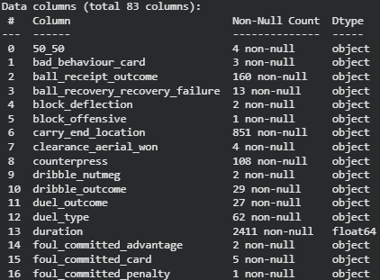
Statsbomb (Events)
Important observation:
Most columns contain NaN values
This is expected because:
  Each event type only uses a subset of
  columns
  Columns not relevant to an event
  remain empty

Slide 14
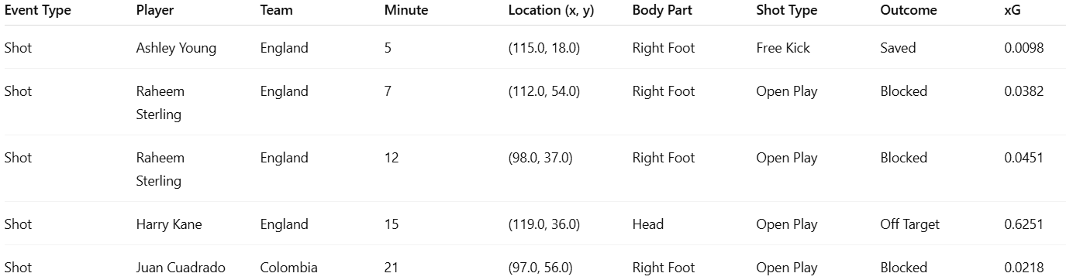
Statsbomb (Events= Shots)
We can extract very specific info (Non-NaN) of a “shot” event

Slide 15
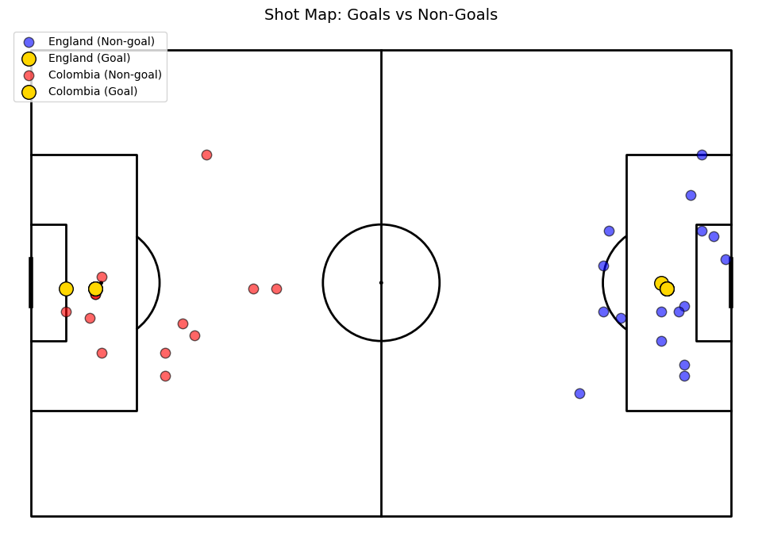
Statsbomb (Visualizing shots)
We can draw standard size football pitch and visualize events using mplsoccer’s Pitch

Slide 16
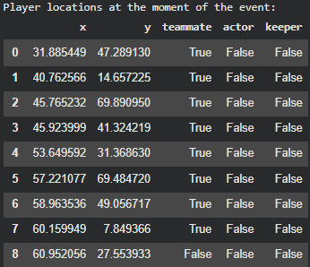
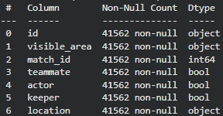
Statsbomb (360 Data)
Statsbomb offers 360 data which track not only location of an event but also players’ location.
360 frame info
Player locations at the moment of
a particular event

Slide 17
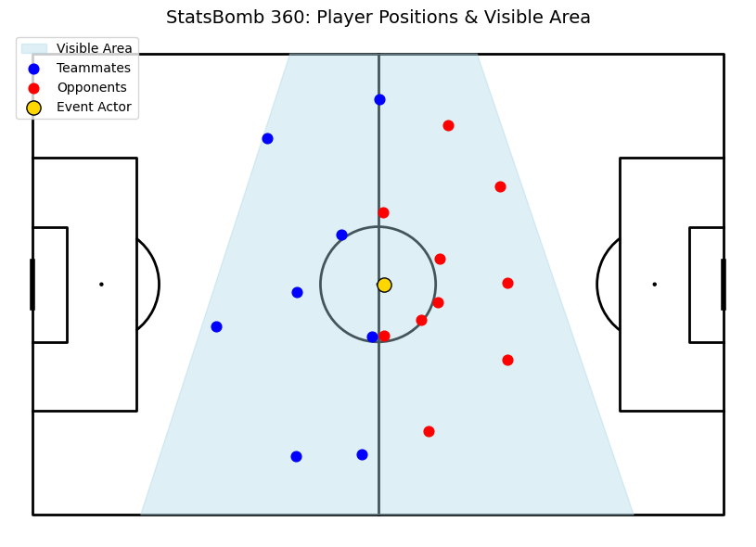
Statsbomb (360 Data)
What can you observe from this pitch image?
Serbia vs Switzerland
Match date: 2022-12-02
Serbia starting formation: 3412
Switzerland starting formation: 4231
These are also extracted by using match_id
and keys like home_team, away_team,
Match_date, type, teactics

Slide 18
Event Data vs Tracking Data
Event Data
Records on-ball actions (passes, shots, tackles, fouls)
Logged only when an event occurs
Sparse data, many NaN columns (not all fields apply to all events)
Used for xG, shot maps, pass maps, KPIs
Tracking Data
Records continuous positions of all players & the ball
Collected every frame (e.g, 10 times/sec)
Dense, large datasets
Used for pressing, team shape, space control, movement analysis

Slide 19
References
Soccermatics Blog: Welcome to Soccermatics — Soccermatics documentation
Course: mathematical modelling of football - YouTube
Book: Soccermatics by David Sumpter

